Slide 1
A walk-through of FreeBSD Hyper-V device drivers
Microsoft
bsdic@Microsoft.com

Slide 2
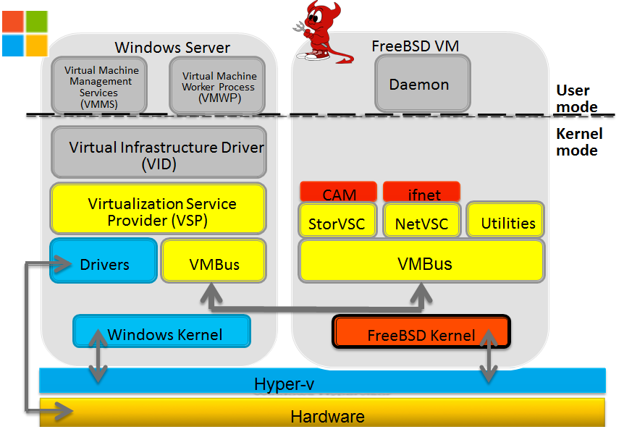
What’s Hyper-V/Azure
Hyper-V is a hypervisor based virtualization platform developed by Microsoft.
Azure provides public cloud service and is primarily based on Hyper-V.

Slide 3
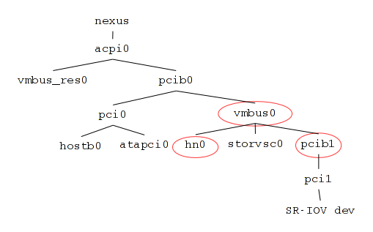
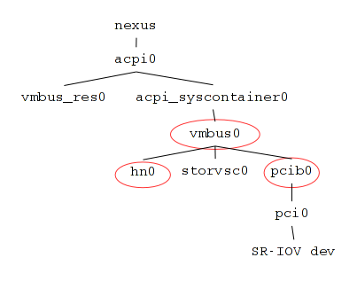
Typical Hyper-V device tree
Hyper-V Generation 1 and Azure
Hyper-V Generation 2

Slide 4
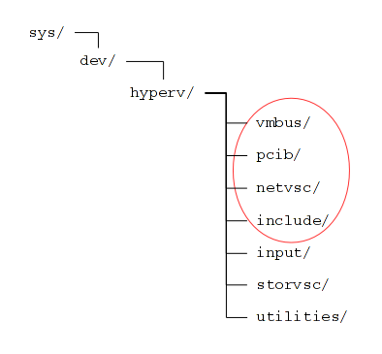
Hyper-V device driver directory layout
vmbus/. The parent of all Hyper-V devices. It also contains code for early initialization, i.e. before any drivers are loaded.
storvsc/. Synthetic SCSI controller driver.
netvsc/. Synthetic network controller driver.
pcib/. PCI bridge driver for SR-IOV/pass-through.
input/. Synthetic keyboard driver.
utilities/. Drivers for KVP, VSS, time synchronization etc.
include/. Shared header files; exposed by the vmbus.

Slide 5
Before any drivers are loaded
Confirm that the underlying hypervisor is Hyper-V.
  Some hypervisor emulates Hyper-V’s signature.
Register guest OS type through MSR.
  This is one of the bits that you may want to customize.
Create Hypercall.
  Hypercall: relatively heavy weight Hyper-V/guest communication mechanism.
Utilize SYSINIT; run before SI_SUB_DRIVERS/SI_ORDER_ANY.
Source code: dev/hyperv/vmbus/hyperv.c

Slide 6
Hyper-V vmbus

Slide 7
Hyper-V vmbus and FreeBSD’s newbus framework
device_identify device method and DRIVER_MODULE macro is convenient to attach child device:
static device_method_t vmbus_methods[] = {
DEVMETHOD(device_identify, vmbus_identify),
…
DRIVER_MODULE(vmbus, pcib, vmbus_driver, vmbus_devclass, NULL, NULL);
…
static void
vmbus_identify(driver_t *, device_t parent)
{
…
device_add_child(parent, ”vmbus”, -1);
}
Only two effective lines of code are needed to hook vmbus0 to pcib0.

Slide 8
Hyper-V vmbus and FreeBSD’s newbus framework
The parent device will have to be cooperative. Here is the one-liner, which is the last missing piece of the puzzle:
dev/acpica/acpi_pcib_acpi.c:
static int
acpi_pcib_acpi_attach(device_t dev)
{
…
/* call device_identify of potential children. */
bus_generic_probe(dev);
if (device_add_child(dev, "pci", -1) == NULL) {
…
}

Slide 9
Hyper-V vmbus and FreeBSD’s newbus framework
device_attach device method has some special requirement:
  All available APs must be activated, since it needs to read/write per-cpu MSRs.
  Properly functioning pause(9) is required.
In the end, the heavy lift of the vmbus_attach is deferred to config_intrhook:
  vmbus_doattach.

Slide 10
Hyper-V’s soul: channel (a quick glance)
Primary channel
Represent a synthetic device, e.g. synthetic network controller.
Possess GUID.
  So that driver can match it against its GUID support list.
Sub-channel
Only exists on device can do heavy I/O.
  e.g. Synthetic network/SCSI controllers as of this write.

Slide 11
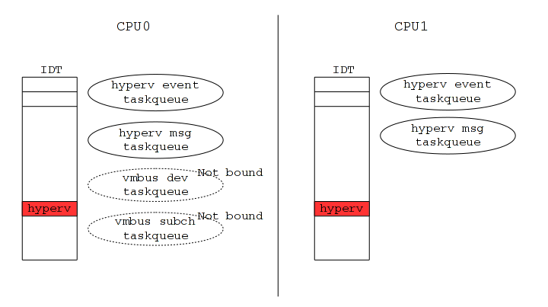
Hyper-V vmbus resource allocation
“hyperv event” taskqueues.
  Per-cpu.
  Run driver’s data path and control path code, e.g. read/write channel.
  Highly active under network/disk load.
“hyperv msg” taskqueues.
  Per-cpu.
  Only the taskqueue running on the cpu0 is actually required.
  Mainly handle channel management messages.
    Channel attach/detach/setup/teardown.
  Mostly idle.
IDT entries.
  Per-cpu.
    One IDT entry on each CPU.
  For both “event” and “msg” interrupts sent by Hyper-V.
  Real works are offloaded to “hyperv msg” and “hyperv event” taskqueues.

Slide 12
Hyper-V vmbus resource allocation
“vmbus dev” taskqueue.
  Only one.
  Create device_t after the corresponding primary channel is created.
  Run driver’s device_probe/device_attach.
  Delete device_t, before the primary channel is about to be destroyed.
    Indirectly run driver’s device_detach.
  Thread-serialized driver’s device_attach/device_detach.
“vmbus subch” taskqueue.
  Only one.
  Handle sub-channel detach notification.
  Mainly to avoid sub-channel detach wait/notification deadlock, if only “vmbus dev” taskqueue existed.

Slide 13
Hyper-V device discovery
Pandora’s box is opened by:
Sending “channel request” message to Hyper-V through Hypercall.
  This message has no reply.

Slide 14
Hyper-V device discovery
Hyper-V sends a set of “channel offer” messages to FreeBSD.
Each “channel offer” message here offers one primary channel.
  Represents one synthetic device.
  e.g. synthetic network controller.
Hyper-V sends “channel offer done” message to FreeBSD.
  After the last “channel offer” message is dispatched to FreeBSD.
The arrival of “channel offer done” is notified from “vmbus dev” taskqueue.
  This implies that all drivers’ device_attach has completed.
  vmbus_doattach returns, so that system can move on to the next config_intrhook.
The attachment of the vmbus is considered done now.

Slide 15
Hyper-V device hot-plug
Hyper-V sends a “channel offer” message to FreeBSD for hot-plugged device.
  Exact same format and meaning as the “channel offer” messages FreeBSD received during Hyper-V device discovery.
  No “channel offer done” message follows.

Slide 16
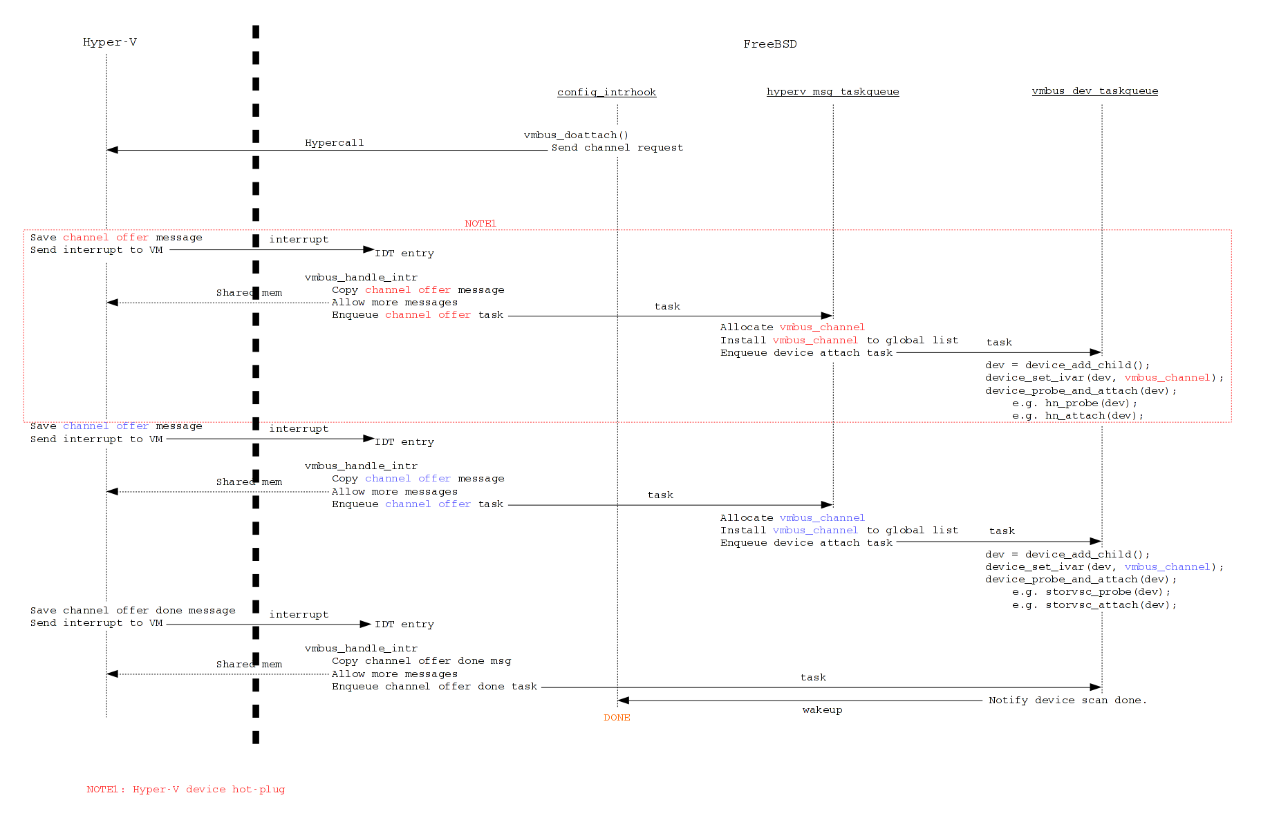
Hyper-V device attachment

Slide 17
Hyper-V device hot-remove
Hyper-V sends a “channel rescind” message to FreeBSD for device about to be hot-removed.
  The “channel rescind” message here contains a primary channel.

Slide 18
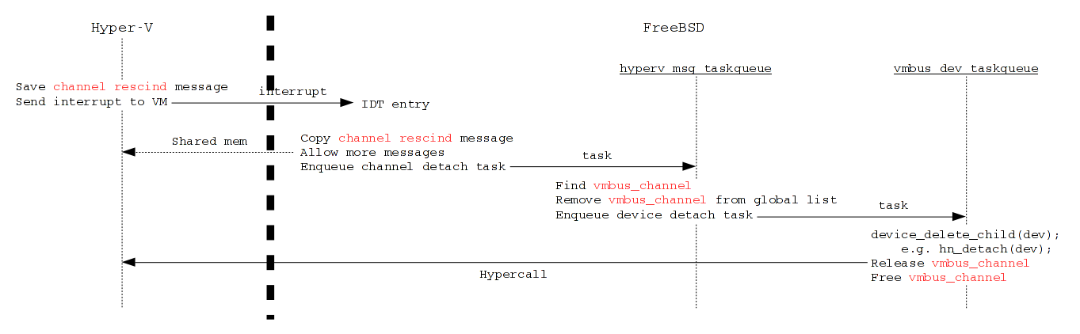
Hyper-V device detachment

Slide 19
Hyper-V vmbus summary
Parent of all Hyper-V devices.
Allocate system resources for channel operation.
Discover/Destroy Hyper-V devices.
  Caller of Hyper-V device’s device_attach/device_detach.
Source code:
  dev/hyperv/vmbus/vmbus.c
  dev/hyperv/vmbus/vmbus_chan.c

Slide 20
Hyper-V’s soul: channel (a close look)

Slide 21
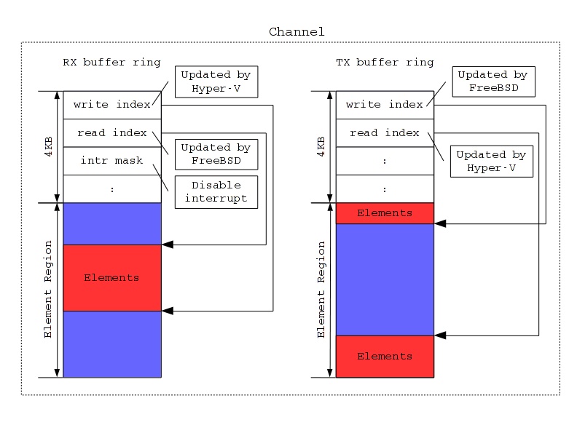
Hyper-V’s soul: channel buffer ring
2 buffer rings.
  First 4KB of buffer ring contains consumer/producer indices and controlling flags.
RX bufring: read data from Hyper-V.
  FreeBSD moves the consumer index.
  Hyper-V moves the producer index.
  Control channel interrupt generation.
TX bufring: send data to Hyper-V.
  FreeBSD moves the producer index.
  Hyper-V moves the consumer index.
  Need to inform Hyper-V, if producer and consumer indices become different.

Slide 22
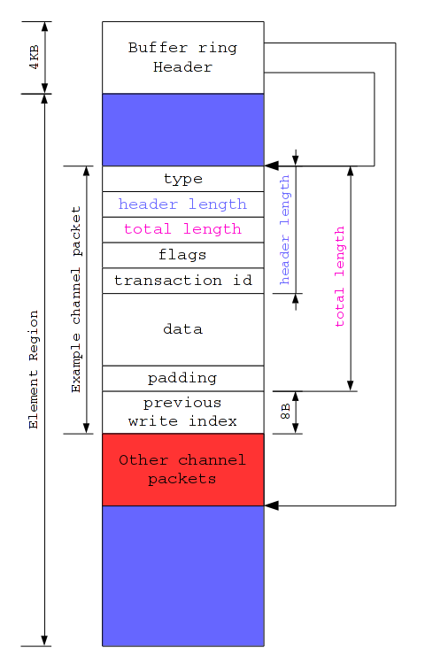
Hyper-V’s soul: channel buffer ring element
Variable length.
Padded to 8 bytes.
Start with fixed size header.
dev/hyperv/include/vmbus.h:
struct vmbus_chanpkt_hdr {
/* type. */
/* header length. */
/*
* element total length.
* include padding.
*/
};
8 bytes trailing debug index.

Slide 23
Hyper-V’s soul: channel
KPIs
dev/hyperv/include/vmbus.h
dev/hyperv/vmbus/vmbus_chan.c
vmbus_chan_open and friends.
  Link FreeBSD provided RX/TX bufring memory with the channel.
  Bind the channel to a specific CPU for interrupt generation.
vmbus_chan_close and friends.
  Revert everything accomplished by vmbus_chan_open.
vmbus_chan_recv/vmbus_chan_send and friends.
  Send/Receive element to/from channel buffer rings.

Slide 24
Hyper-V driver example: network controller

Slide 25
Hyper-V driver example: network controller
Unlike real hardware, there are no CSRs.
Both control and data path use “Network Virtualization Service” messages.
  We call it NVS message later on.
Two control components:
  Network Virtualization Service (NVS).
    Use NVS message directly.
  NDIS.
    Wrap RNDIS message in NVS message.
Data path uses RNDIS messages wrapped in NVS message.

Slide 26
Hyper-V driver example: network controller device_attach
Open the primary channel.
  Primary channel is attached to device_t as ivars by vmbus.
  All of the control NVS/RNDIS messages must use primary channel to send.
Initialize NVS.
  Set MTU?!
    Cause headache when change MTU through ifnet.if_ioctl.
  Negotiate NDIS version.
  Attach RX buffer, and chimney sending buffer.
Initialize NDIS.
  TSO setup.
  TX/RX checksum offload setup.

Slide 27
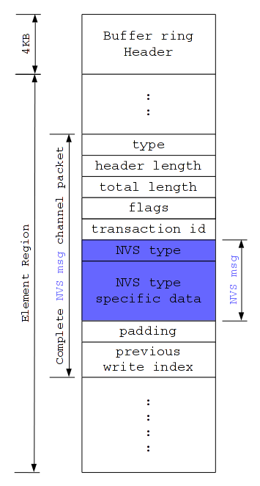
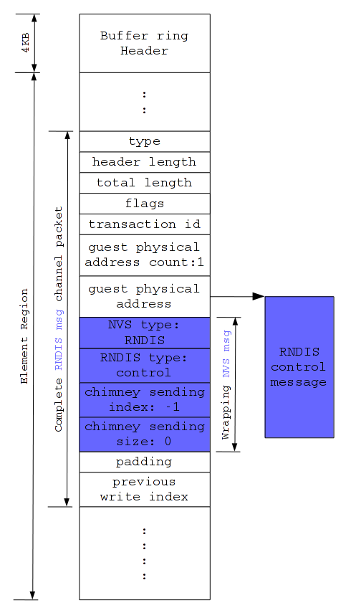
Hyper-V network controller: control messages on the TX buffer ring
NVS message
RNDIS message

Slide 28
Hyper-V driver example: network controller device_attach
Allocate sub-channels from NVS for multiple TX and RX rings support.
  Each channel consists one RX ring and one TX ring.
  Synchronous operation.
Open all sub-channels.
  For data path only.
  Primary channel is also used by data path.
Setup RSS Toeplitz key and redirect table.
  Entry in redirect table contains relative index of channel.
    0 for the primary channel, 1 for the first sub-channel, etc.

Slide 29
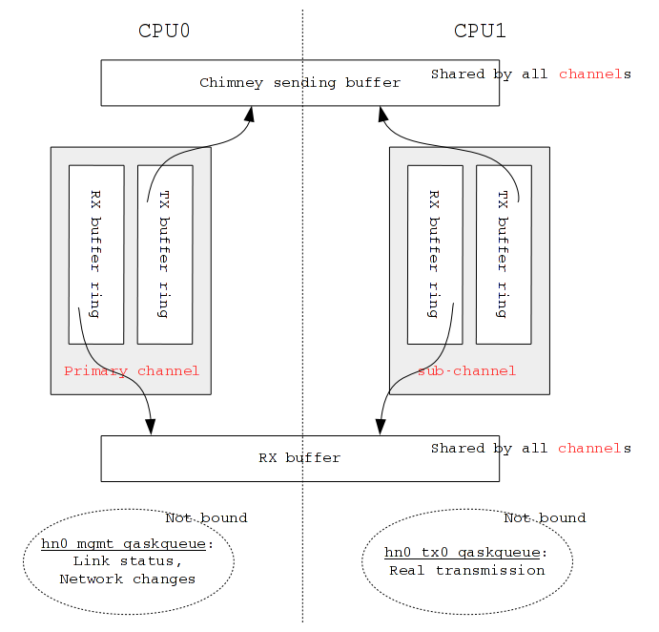
Hyper-V network controller: resources for 2 RX/TX rings

Slide 30
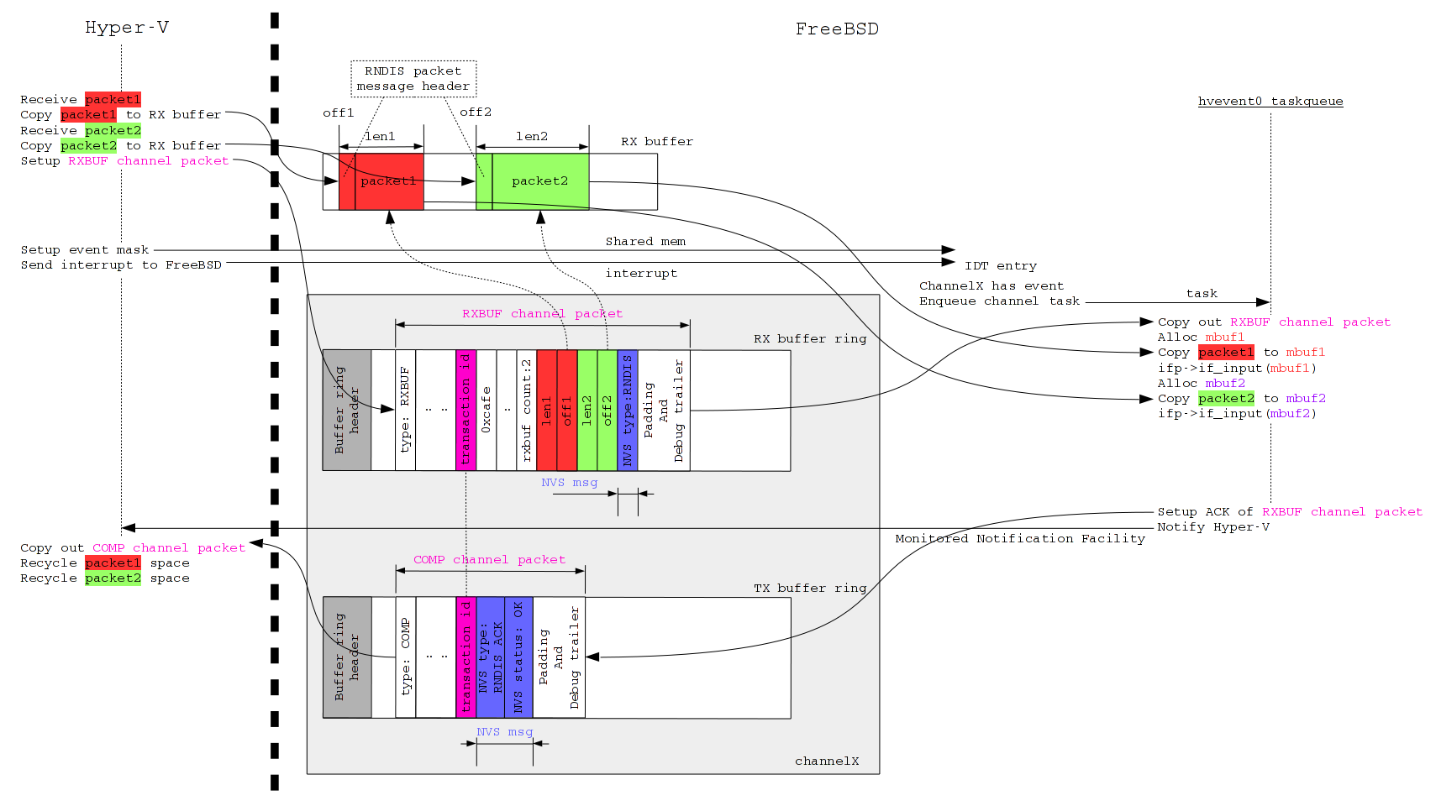
Hyper-V network controller: RX path

Slide 31
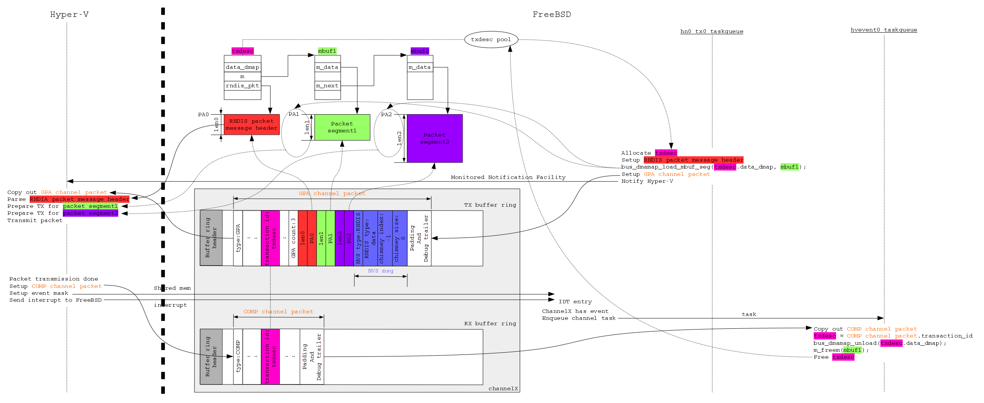
Hyper-V network controller: TX path

Slide 32
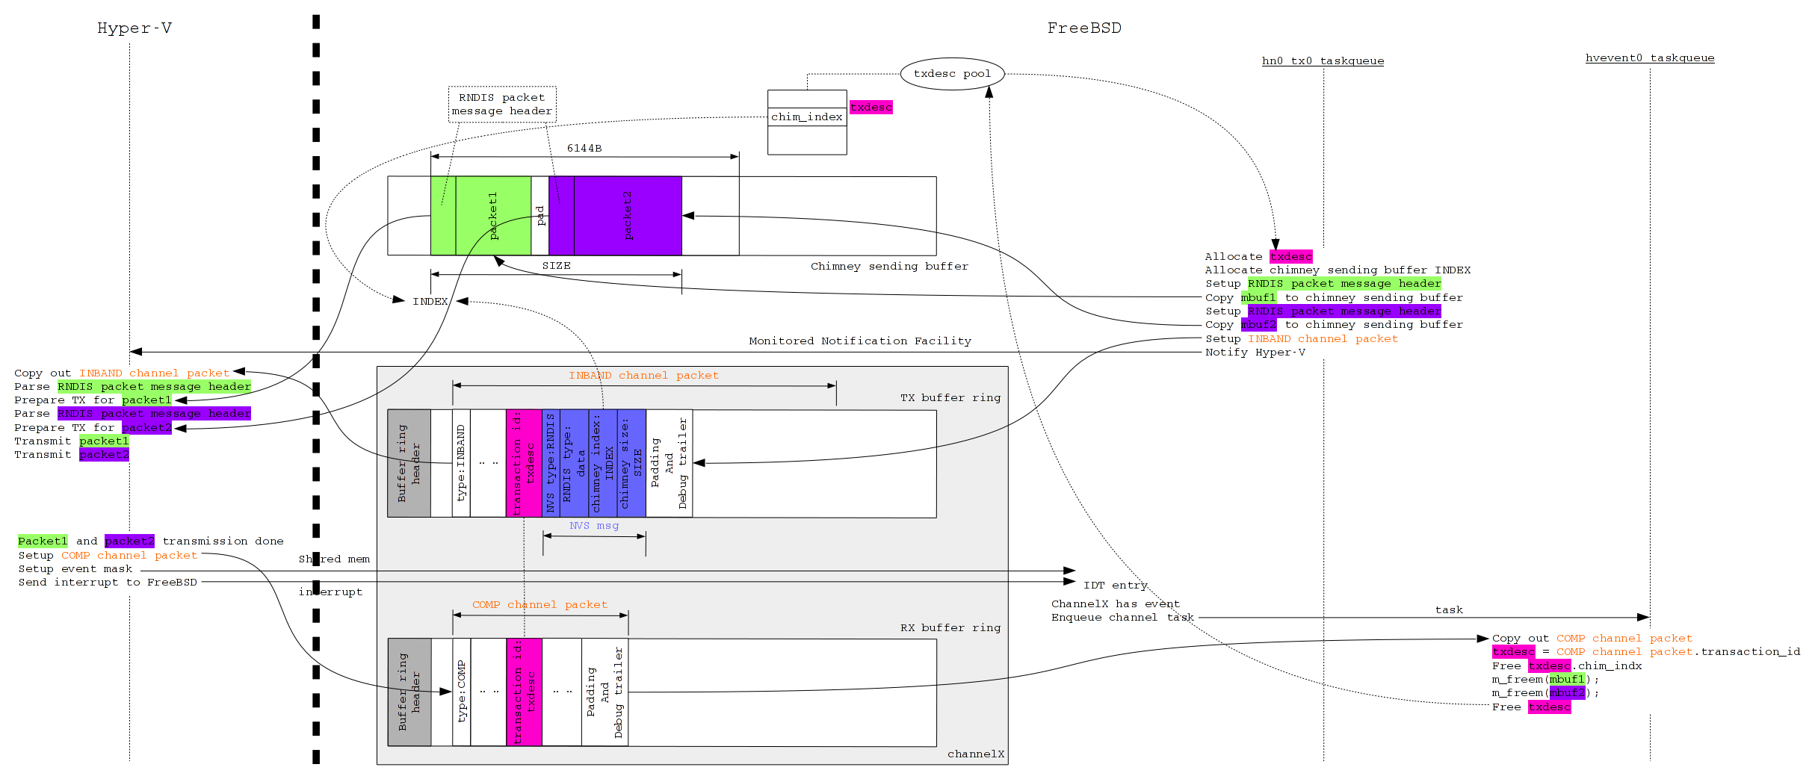
Hyper-V network controller: chimney sending

Slide 33
Hyper-V driver example: network controller
Caveat
Extra care must be taken when change MTU
MTU is a setting for NVS during NVS initialization.
To change MTU:
  Destroy RNDIS.
  Destroy NVS.
  Reinitialize NVS and RNDIS like what we do in device_attach.

Slide 34
Hyper-V driver example: network controller
Summary
Source code:
dev/hyperv/netvsc/if_hn.c
dev/hyperv/netvsc/hn_nvs.c (Network Virtualization Service)
dev/hyperv/netvsc/hn_rndis.c (RNDIS)

Slide 35
Hyper-V driver example:
PCI SR-IOV/pass-through

Slide 36
Hyper-V driver example:
PCI SR-IOV/pass-through
Background
Hyper-V does not emulate a full-fledged PCI bridge.
A cooperative PCI bridge driver is needed on FreeBSD.
  Handle PCI configuration space accessing.
  Setup BARs for SR-IOV/passed-through devices.
  Remap MSI/MSI-X data and address.
One PCI bridge per SR-IOV/passed-through device.
  As of this write.

Slide 37
Hyper-V driver example:
PCI SR-IOV/pass-through
Usable memory mapped I/O space
Required by:
  PCI configuration space access.
  SR-IOV/passed-though device’s BARs.
Where to find them, AcpiWalkResources(…, “_CRS”, …):
  acpi0 _CRS (none, as of this write).
  ACPI VMBUS _CRS (none, as of this write).
  For Generation 1 Hyper-V, host-pci bridge _CRS, i.e. pcib0 _CRS
  For Generation 2 Hyper-V, ACPI ACPI0004 _CRS.
Prefer high 32-bits MMIO spaces for 64-bits BARs.

Slide 38
Hyper-V driver example:
PCI SR-IOV/pass-through
Usable memory mapped I/O space
Implemented in vmbus:
dev/hyperv/vmbus/vmbus.c
vmbus_get_mmio_res
Use pcib_host_res KPIs to maintain usable spaces.

Slide 39
Hyper-V driver example:
PCI SR-IOV/pass-through
PCI Bridge
A primary channel.
  No sub-channels; not a device used for heavy I/O.
Use DEFINE_CLASS_0(pcib, …)
  Most of the device methods inherited from dev/pci/pcib.c.
A small set of device methods require overridden.

Slide 40
Hyper-V driver example:
PCI SR-IOV/pass-through
Device method overrides (1)
pcib_config_read and pcib_config_write
Through 4KB aligned (size 8KB) memory mapped I/O space.
  Allocated from vmbus.
  Negotiated with Hyper-V, before it can be used.
  e.g. PCI capabilities.
Some come from Hyper-V provided data directly.
  e.g. Device id and vendor id.

Slide 41
Hyper-V driver example:
PCI SR-IOV/pass-through
Device method overrides (2)
Resource management device methods
Most of them just pass the calls to the parent, i.e. vmbus.
Only memory mapped I/O is supported.
Rely on FreeBSD’s generic pci code to setup the BARs of SR-IOV/passed-through devices.

Slide 42
Hyper-V driver example:
PCI SR-IOV/pass-through
Device method overrides (3)
Interrupt management device methods.
Only MSI/MSI-X are supported.
Most of them just pass the calls to the parent, i.e. vmbus.
pcib_map_msi
  Use the MSI/MSI-X data/address from nexus as input to Hyper-V.
  Hyper-V sends back “remapped” MSI/MSI-X data/address.
  The “remapped” MSI/MSI-X data/address will be written to the device.

Slide 43
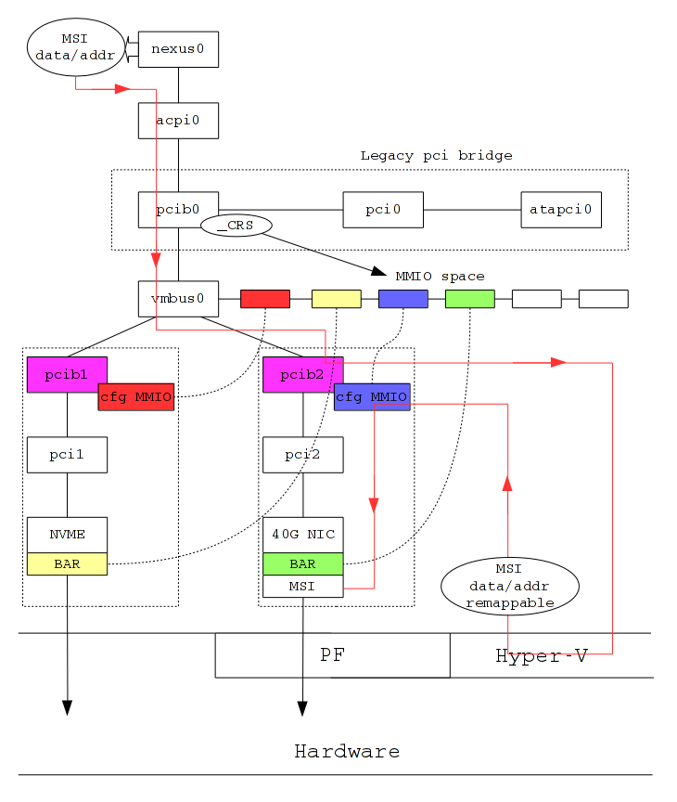
Hyper-V PCI SR-IOV/pass-through

Slide 44
Hyper-V driver example:
PCI SR-IOV/pass-through
Network SR-IOV
The only tested type of SR-IOV devices so far.
Tightly coupled with Hyper-V synthetic network devices.
  Share the same MAC address.
Require cooperation from Hyper-V synthetic network device driver.
  Switch data path to/from SR-IOV device.
ifnet_event and ifaddr_event EVENTHANDLERs
  Once SR-IOV controls data path, pretend that the RXed packets are from SR-IOV device.

Slide 45
Hyper-V driver example:
PCI SR-IOV/pass-through
Summary
Source code:
dev/hyperv/vmbus/vmbus.c (usable memory mapped I/O space)
dev/hyperv/pcib/vmbus_pcib.c (PCI bridge)
dev/hyperv/netvsc/if_hn.c (Network SR-IOV)

